Slide 1
Shop Safety Inspections

Slide 2
Program Overview
Initiated in FY 2020-21
Inspections occur on an annual cycle
Findings require correction and due date depends on priority level
Inspection reports are submitted and corrections are tracked through the UC Inspect application
Inspection metrics presented to Unit Leadership and to AVC/Assistant Dean quarterly

Slide 3
Shop Inspections Process and Timeline
1
SCHEDULING
EHS coordinates with Responsible Persons to schedule annual shop inspections.
Scheduled within same point in time (quarter) as last year’s inspection.
INSPECTION
Shop inspection is conducted and findings are recorded for inspection report.
Report is sent out within 3 days after inspection.
3
REPORT
EHS sends report to unit’s Responsible Person to correct findings.
Findings must be closed by the due date indicated in report.
2
4
5
CLOSURE
Unresolved findings are escalated to next level personnel if not resolved by due date.
METRICS
Inspection metrics are presented to area/school Director and AVC in quarterly meetings.

Slide 4
Preparing for Shop Safety Inspections
EHS staff will identify the responsible person for unit
EHS staff will schedule shop safety inspection (typically 3-4 weeks out)
  The annual inspection schedule is posted on the EHS website: https://www.ehs.uci.edu/safety/safety-inspection-programs/_pdf/Shop-Inspection-Schedule.pdf
EHS inspects shops based on an established criteria checklist
When the inspection report is submitted to the unit, the report is reviewed and the findings are addressed based on established priority levels

Slide 5








Items reviewed during the Shop Safety Inspection
Machine guarding
Fire and Life Safety
Training Records
Electrical Safety
Personal Protective Equipment
Chemical Safety & Storage
Housekeeping
Pressurized Cylinder Safety

Slide 6
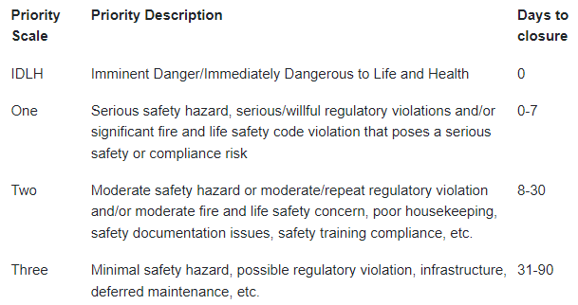
Inspection Escalation Process
This high level process ensures accountability in resolving outstanding safety hazards in labs and how EH&S will attempt to obtain closure on lab safety inspection findings.
https://www.ehs.uci.edu/research-safety/pdf/escalation-criteria-and-process.pdf

Slide 7
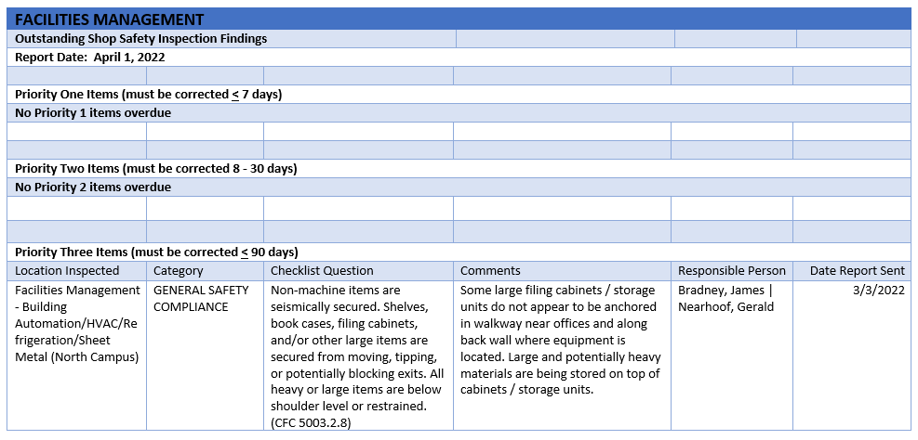
Escalation Process
Find the Escalation Flowcharts for:
  Research labs - https://ehs.uci.edu/safety/safety-inspection-programs/_pdf/Non-Research-Escalation-Process-Flowchart.pdf
  Non-research areas - https://www.ehs.uci.edu/safety/safety-inspection-programs/_pdf/Non-Research-Escalation-Process-Flowchart.pdf
If findings are not addressed/corrected by the agreed due date, escalation is initiated by EHS / Safety Unit
Escalation reports (open findings) are generated monthly and forwarded to the EHS School/unit coordinator and Unit Management
Open findings are shared with unit leadership (Assistant Dean, department Director, etc.) at the quarterly or biannual EHS school/unit check-in meetings.
Sample Escalation Report:

Slide 8
Shop Safety Inspection Program Resources
Resources available on the EHS Website:
https://ehs.uci.edu/safety/safety-inspection-programs/index.php
You will find the following material on the website:
  Shop Safety Written Program
  Safety Training Options (ILT, online training)
  UCOP Shop Safety Manual
  STOP for Safety
  Standard Operating Procedures (SOP)
  Inspection Process
  EHS Escalation Criteria and Process
  Additional information (EHS contacts, other Safety program resources)

