Slide 1
Conversion and Transition to UC Chemicals Chemical Inventory System
Overall Project Plan
Notes:
Kickoff welcome
Get everyone to sit down
Thank them for coming
Town hall isn’t just for receiving information, but a great way to meet team members under the A&BS umbrella
Transition to ice breaker – meet your neighbor

Slide 2
Chemical Inventories: Problems and Solutions
Problem with current state of chemical inventories:
  Chemical inventories are required to be updated regularly, and at least annually.
  UCI uses 3 different chemical inventory databases that creates difficulties when collecting data reports.
  Out-of-date information is problematic when determining allowable quantities of flammable chemicals or pyrophorics.
Solution: Transition all existing chemical inventories contained in different databases into UC Chemicals, while providing an efficient and user-friendly chemical inventory system, allowing for real-time inventory updates
Other benefit: Assist in providing first responders with accurate and up-to-date chemicals in affected spaces, allows review of current inventory before approving new chemicals to be purchased
Project Goal: Fully transition all UCI units’ chemical inventories into UC Chemicals application

Slide 3
Benefits of Using UC Chemicals
Updated inventory will provide real-time data in assisting with Maximum Allowable Quantities (MAQs) for limits of flammable chemicals volume in buildings’ control zones
Accurate inventories prevent unnecessary duplications
UC Chemicals application is easy to use on any device
RFID tags and QR codes greatly reduce the time needed to complete and update inventory
Chemical inventory reconciliation can occur quickly and easily

Slide 4
UC Chemicals Application and Tools
Risk and Safety Solutions application:
UC Chemicals: Chemicals (riskandsafety.com)
Project supplies:
  iPads, carts, QR and RFID tags
  PPE (safety glasses, lab coats, gloves)

Slide 5
Container Labels
EHS staff perform inventory by attaching labels to containers:
  QR codes
    Easy to identify chemicals in inventory; each container is scanned individually
    Allows labs to reconcile by sublocation so it is easier to find missing or misplaced containers and reports are more accurate
  RFID tags
    Allows for easy room location reconciliation using RFID scanner
    Rooms can be scanned quickly with a QR scanner and uploaded into a reconciliation report
  Freezer Tags
    Used in conjunction with QR and RFID tags for frost-covered containers

Slide 6
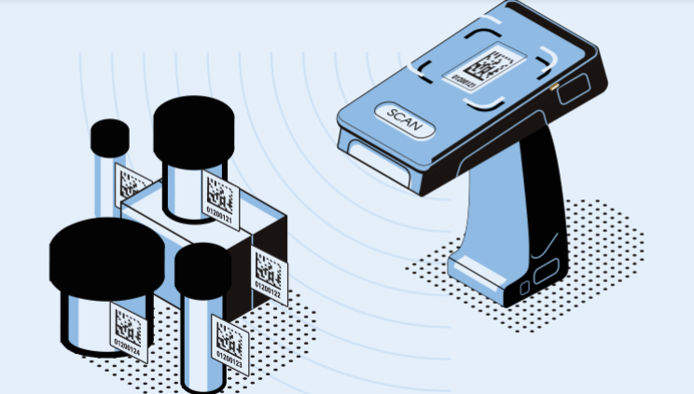
RFID Tag Technology and Features
Risk and Safety Solutions RFID Tag Technology:
https://youtu.be/llKkZQEVKVY
Readable from 2 to 3 feet
Small enough to affix directly to containers
Must have QR barcode for location purposes
Works on multiple types of containers and contents
Solvent resistant laminate, double-sided

Slide 7
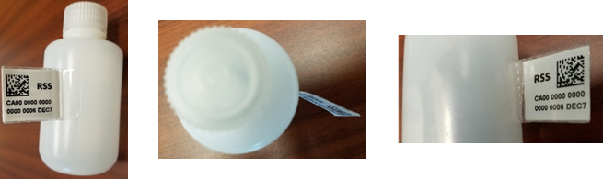
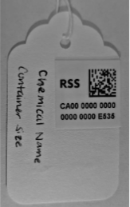
Types of Labels
QR code tag
Freezer Tag

Slide 8
Reconciliation and Maintenance
Inventory maintenance:
  As labs purchase more chemicals, new containers should be added to inventory, and delete the empty containers that are being disposed.
  Chemical containers can be deleted using a mobile device by scanning the QR code
Annual self-verification and attestation:
  UCI requires annual reconciliation of chemical inventories and labs must certify that their chemical inventory is up-to-date
EHS-led lab safety inspections:
  Annual inspections look for chemical inventory reconciliation over the last year by comparing physical inventory to what is in UC Chemicals and the last time the inventory was certified

Slide 9
Responsibilities
EHS:
Assist with transition of chemical inventory to UC Chemicals
Provide RFID labels, provide RFID scanners
Run chemical inventory reports for MAQs of flammables, oxidizers, pyrophorics
Researchers/Labs:
Maintain chemical inventories in UC Chemicals when bringing in new chemicals or disposing chemicals
Reconcile and self-certify chemical inventory annually

Slide 10
After the transition is completed:
EHS provides the following instructions to labs:
  Chemical inventories must be updated when chemicals are used up and when new chemicals are brought into the lab.
  All chemicals and gases must be barcoded. Barcodes are available at these locations: https://www.ehs.uci.edu/enviro/haz-waste/pdfs/self-service-empty-container-locations.pdf
  Conduct a complete inventory reconciliation of your lab spaces at least once a year. RFID and QR scanners are available through EHS.
  Dispose of materials that are no longer useful, should be replaced, have deteriorated, or show container degradation.

Slide 11
Communication to Campus
Research Laboratories
  Annual Email from Vice Chancellor of Research:
  message-from-pramod-khargonekar.pdf (uci.edu)
Communication strategy
  Labs are provided a two-page instructional sheet on how to access UC Chemicals, add/delete chemicals and a link to the chemical inventory webpage with more resources. The lab is also provided barcodes for new chemicals.
  EHS Coordinator will send out an email with the instructional sheet and links to the chemical inventory webpage. It will also explain the labs responsibilities to keep the chemical inventory up to date. This includes 3 important steps:
    adding new chemicals to UC Chemicals and assigning a barcode
    deleting chemicals as they are used up or disposed of
    reconciling their inventory annually (comparing physical inventory to the digital inventory in UC Chemicals)
  EHS inspectors will ask labs if they are doing the 3 steps mentioned above during the annual lab inspection. If they are not up to date, it will be a finding and the Coordinator will assist in getting them up to date.
  Coordinators will demonstrate how to use UC Chemicals and review the chemical inventory website during safety orientations. They will also discuss their responsibilities and what steps they need to take to maintain their chemical inventory.
Communication to non-lab units:
  Student Affairs units
  Athletics
  Facilities Management
  School of the Arts

Slide 12
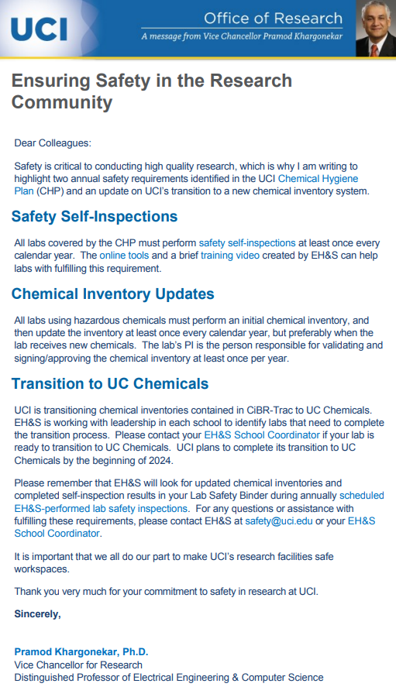
Release date/annual email: Oct 2021

Slide 13
Two different approaches to transition inventory to UC Chemicals
For researchers to transition inventory to UC Chemicals
Method 1: Researchers to barcode own inventory
Method 2: EHS to assist in barcoding inventory

Slide 14
Methodology – Option 1
Option 1: Labs barcode their own inventory using QR codes and RFID tags
Instructions are available at https://www.ehs.uci.edu/research-safety/chemical-safety/index.php
Barcodes can be found at these locations: https://www.ehs.uci.edu/enviro/haz-waste/pdfs/self-service-empty-container-locations.pdf
Pros: -Good for small labs, fewer chemical containers
-PI or researchers don’t want others touching containers
Cons: Research staff not affixing labels correctly

Slide 15
Methodology – Option 2
Option 2: EHS staff assist in barcoding the labs inventory
EHS School Coordinators works with UC Chemicals Supervisor to schedule specific labs in their respective schools
For efficiency, work is completed by building, and by floor, to minimize travel time and scheduling complications
EHS School Coordinators assist Chemicals Supervisor by sending out the following message:
To prepare for the transition, please ensure the following:
  At least one member of your lab is present at all times the students are working
  UC Chemicals is set up with all of your desired sublocations added into the system prior to the students arriving
    Login to chemical inventory https://app.riskandsafety.com/chemicals/, click on "Inventory Summary", then "Sublocations +" to add new locations or modify by clicking on the ellipse (...)
  Inform students of any special hazards or high hazard materials (e.g. highly toxic materials, pyrophorics, etc.).
  Remove all high hazard materials from any location the student is barcoding.

Slide 16
Option 2: EHS Staff conducts transition
Student Employee Teams
  EHS staff go into labs in teams of 2 to 3
  SME/Student Team Lead assigned to communicate with EHS project manager, report on status of supplies, and any issues with labs
  Students are trained on recognizing hazards, how to properly handle containers
  Bring up concerns to EHS SME/supervisor (Research Safety Manager)
  Data entry averages ~2 – 3 minutes per container
  Academic Year: about 10 students working at least 10-12 hours per week, up to 19 hours per week (desired)
  Summer (June through mid September): about 10 students working at least 30 hours per week, up to 40 hours per week (desired)
  Composition of student employees:
    Undergraduates and graduate students
    Work study, non-work study

Slide 17
Option 2: EHS assists with inventory
98% of chemical inventory transition work is performed via Option 2
Pros
  EHS staff completes chemical inventory for lab
Cons
  EHS staff needed to perform inventory work
  EHS staff may miss chemical container locations

Slide 18
UC Chemicals Supervisor (Career staff)
Responsibilities
  Interviews and hires students
  Provides training on tagging process
  Provides safety training on how to work safely and wear PPE
  Creates schedule for student teams
  Notifies academic school EHS School Coordinators to communicate schedule to individual labs and PIs
  Performs quality assurance of data input vs. actual chemical container information
  Creates monthly Chemicals scorecard

Slide 19
Container Labeling Conditions
Students barcode chemicals and gases in standard storage locations (e.g. benchtops, flammable cabinets, corrosive cabinets, gas cabinets, chemical cabinets, etc.)
Students do not barcode chemicals in special storage environments without assistance from the lab (e.g. gloveboxes, fridges, freezers, desiccators, controlled substance cabinets).
The students do not barcode containers that are degraded, damaged, unreadable, etc. Damaged containers are disposed of through EHS.
Note: If lab is performing their own barcoding of containers, they label all of their containers based on their knowledge of the hazards in the lab.

Slide 20
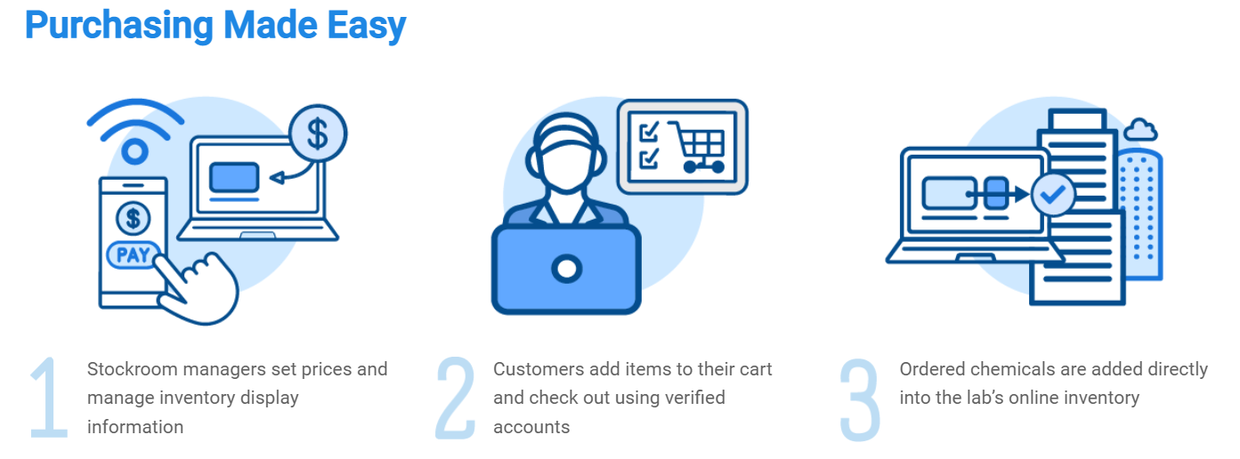
Additional Feature of UC Chemicals
Store Front Function
  Software developer (RSS) is working with UCI to create functionality with Physical Sciences Stores (PS Stores) in order to capture incoming chemical containers to be entered into UCI Chemicals
Tentative go-live for Store Front function: January 2023

Slide 21
Project Scorecard
Metrics:
  Month-by-month schedule
  Projected schedule vs. actual completion
  Number of labs and containers completed
  Number of labs remaining, by school
  Student Employee Hours Worked
  Budget spent and remaining
Frequency: Monthly scorecard sent to EHS Executive Director
Communication: Quarterly progress reported to VC Research and to campus wide Lab Safety Committee
Anticipated overall project completion: June 2023

